Slide 1
Cascading Style Sheets

Slide 2
Div and CSS
The <div> element is used as a container for other HTML elements.
div is a generic container element that does not carry any semantic meaning. It is mostly used for grouping related elements together and applying styling to them via CSS.
The <div> element is by default a block element, meaning that it takes all available width, and comes with line breaks before and after.
<div>Here comes the Div </div>

Slide 3
<div> as a container
div is a generic container element that does not carry any semantic meaning. It is mostly used for grouping related elements together and applying styling to them via CSS.
The <div> element is often used to group sections of a web page together.

Slide 4
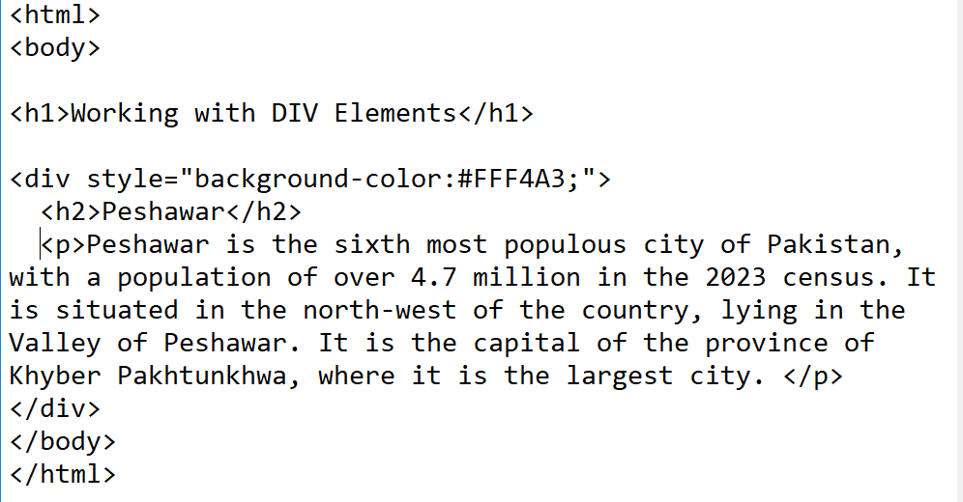
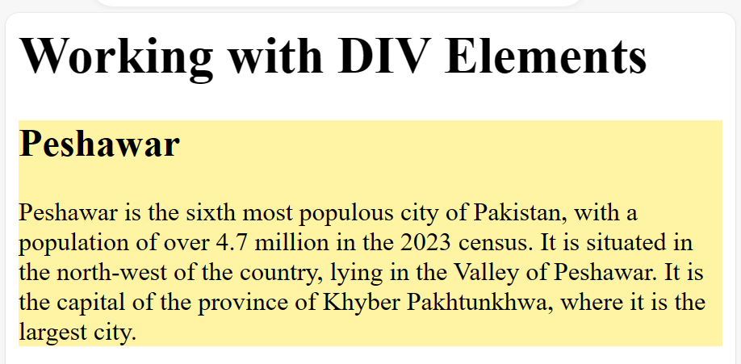

Slide 5
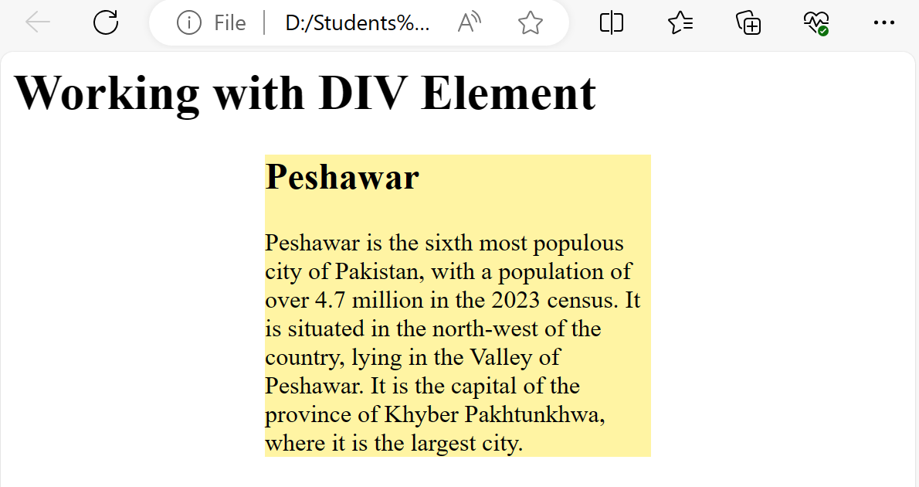
Center Aligning Div
<style>
div {
width:250px;
margin:auto;
}
</style>

Slide 6
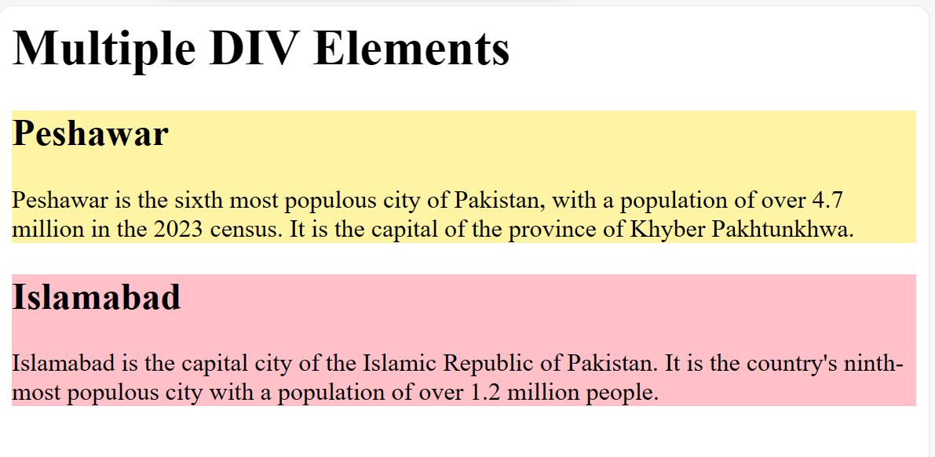
Multiple Div elements
<html>
<body>
<h1>Multiple DIV Elements</h1>
<div style="background-color:#FFF4A3;">
<h2>Peshawar</h2>
<p>Peshawar is the sixth most populous city of Pakistan, with a population of over 4.7 million in the 2023 census. It is the capital of the province of Khyber Pakhtunkhwa. </p>
</div>
<div style="background-color:#FFC0C7;">
<h2>Islamabad</h2>
<p> Islamabad is the capital city of the Islamic Republic of Pakistan. It is the country's ninth-most populous city with a population of over 1.2 million people.</p>
</div>
</body>
</html>

Slide 7
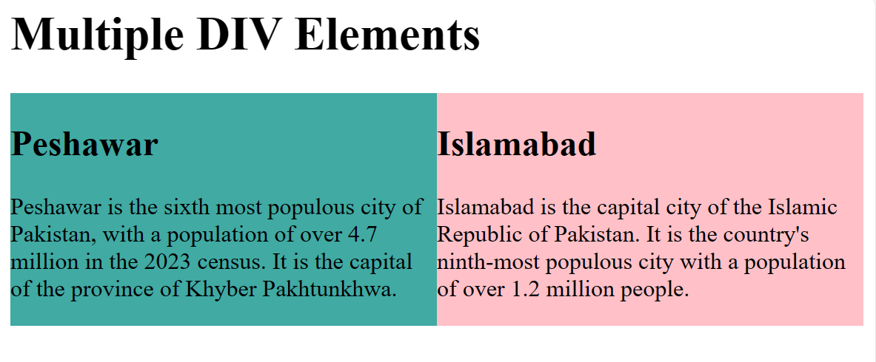
<html>
<head>
<style>
div.mycontainer {
width:100%;
overflow:auto;
}
div.mycontainer div {
width:50%;
float:left;
}
</style>
</head>
<body>
<h1>Multiple DIV Elements</h1>
<div class = "mycontainer">
<div style="background-color:#40AAA3;">
<h2>Peshawar</h2>
<p>Peshawar is the sixth most populous city of Pakistan, with a population of over 4.7 million in the 2023 census. It is the capital of the province of Khyber Pakhtunkhwa. </p>
</div>
<div style="background-color:#FFC0C7;">
<h2>Islamabad</h2>
<p> Islamabad is the capital city of the Islamic Republic of Pakistan. It is the country's ninth-most populous city with a population of over 1.2 million people.</p>
</div>
</div></body></html>

Slide 8
<section>
The <section> HTML element represents a generic standalone section of a document.
Section tag is used to distribute the content with a similar theme. The main advantage of the section tag is, it describes its meaning in a web page. It is mostly used when headers, footers, or any other section of documents are needed in a web page. Requires closing </section> tag too.
<section> <h2>About Us</h2> <p>We are a team of passionate developers...</p> </section>

Slide 9
CSS selectors
CSS selectors are used to "find" (or select) the HTML elements you want to style and can be divided into five categories:
Simple selectors (select elements based on name, id, class)
Combinator selectors (select elements based on a specific relationship between them)
Pseudo-class selectors (select elements based on a certain state)
Pseudo-elements selectors (select and style a part of an element)
Attribute selectors (select elements based on an attribute or attribute value)

Slide 10
Combinator selectors
A CSS selector can contain more than one simple selector. It explains the relationship between the selectors
descendant selector (space)
child selector (>)
adjacent sibling selector (+)
general sibling selector (~)

Slide 11
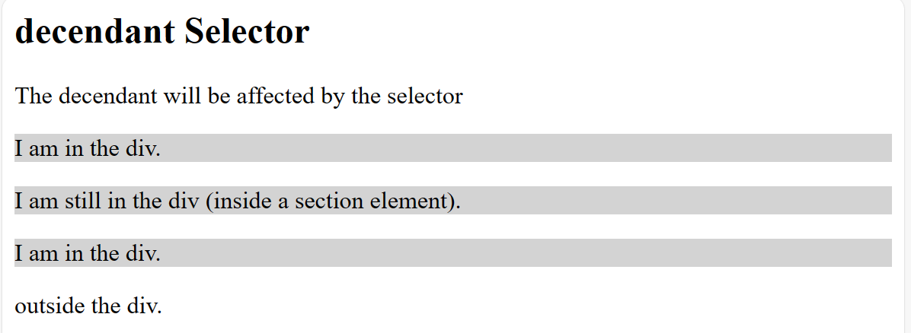
Combinator selectors
<style>
div p {
background-color: lightgrey;
}
</style>
</head>
<body>
<h2>decendant Selector</h2>
<p>The decendant will be affected by the selector </p>
<div>
<p>I am in the div.</p>
<section>
<p>I am still in the div (inside a section element).</p>
</section>
<p>I am in the div.</p>
</div>
<p>outside the div.</p>

Slide 12
Child Selector (>)
The child selector selects all elements that are the children of a specified element.

Slide 13
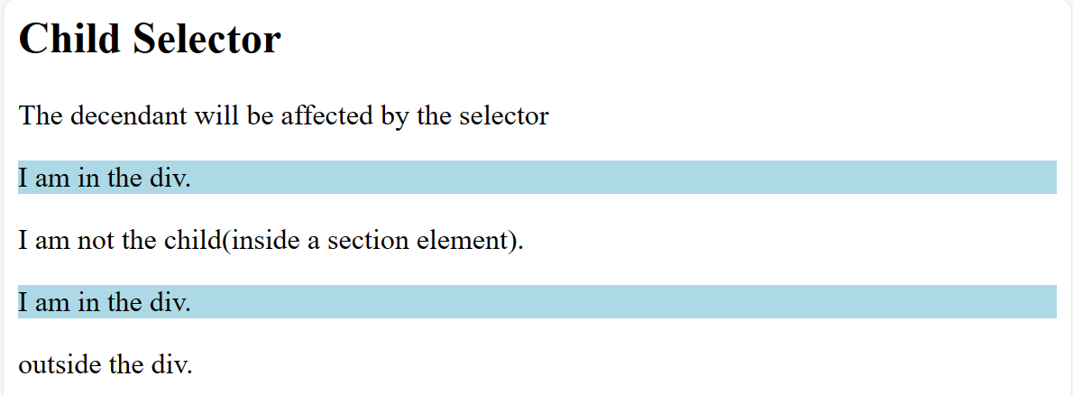
Child Selector (>)
<style>
div > p {
background-color: lightblue;
}
</style>
</head>
<body>
<h2>Child Selector</h2>
<p>The decendant will be affected by the selector </p>
<div>
<p>I am in the div.</p>
<section>
<p>I am not the child(inside a section element).</p>
</section>
<p>I am in the div.</p>
</div>
<p>outside the div.</p>

Slide 14
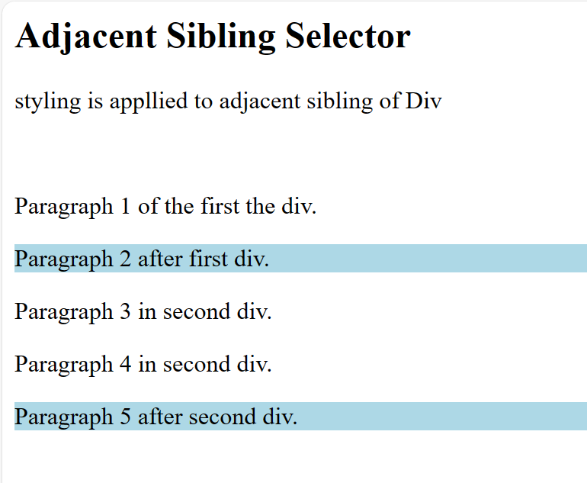
Adjacent Sibling Selector
<style>
div + p {
background-color: lightblue;
}
</style>
</head>
<body>
<h2>Adjacent Sibling Selector</h2>
<p> styling is appllied to adjacent sibling of Div</p><br>
<div>
<p>Paragraph 1 of the first the div.</p>
</div>
<p>Paragraph 2 after first div.</p>
<div>
<p>Paragraph 3 in second div.</p>
<p>Paragraph 4 in second div.</p>
</div>
<p>Paragraph 5 after second div.</p>

Slide 15
General Sibling Selector (~)
General Sibling Selector (~)
The general sibling selector selects all elements that are next siblings of a specified element.
The following example selects all <p> elements that are next siblings of <div> elements:

Slide 16
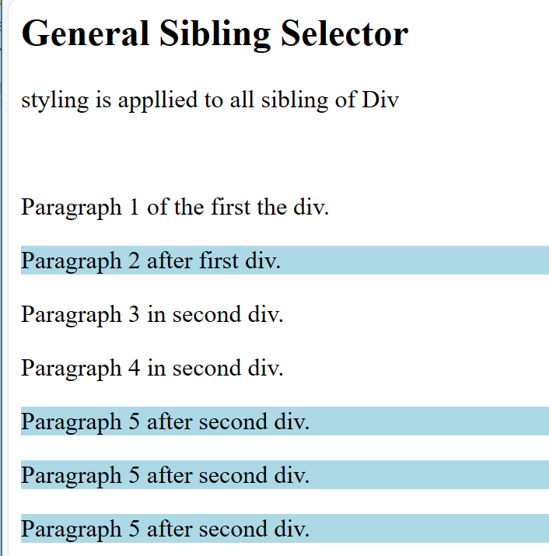
General Sibling Selector (~)
<style>
div ~ p {
background-color: lightblue;
}
</style>
</head>
<body>
<h2>General Sibling Selector</h2>
<p> styling is appllied to all sibling of Div</p><br>
<div>
<p>Paragraph 1 of the first the div.</p>
</div>
<p>Paragraph 2 after first div.</p>
<div>
<p>Paragraph 3 in second div.</p>
<p>Paragraph 4 in second div.</p>
</div>
<p>Paragraph 5 after second div.</p>
<p>Paragraph 5 after second div.</p>
<p>Paragraph 5 after second div.</p>

Slide 17
Pseudo-class selectors
A pseudo-class is used to define a special state of an element.
It can be used to:
Style an element when a user mouses over it
Style visited and unvisited links differently
Style an element when it gets focus
selector:pseudo-class { property: value; }

Slide 18
Pseudo-class selectors
a:link { color: #FF0000; } /* visited link */ a:visited { color: #00FF00; } /* mouse over link */ a:hover { color: #FF00FF; } /* selected link */ a:active { color: #0000FF; }
Extends function of an element
The hover pseudo class is dynamically activated when the user move the mouse cursor over an A element
Allows author access to content not specifically declared in the document
A:hover { text-decoration: underline; color: red; background-color: #CCFFCC }

Slide 19
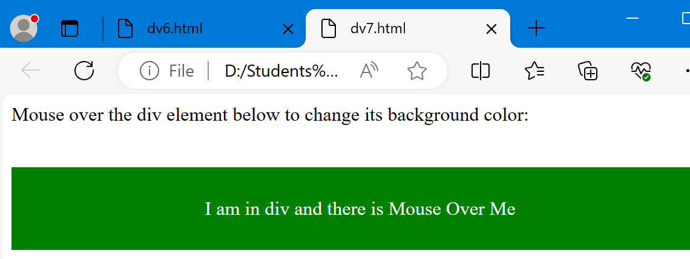
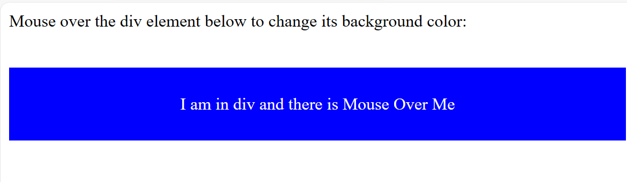
<html>
<head>
<style>
div {
background-color: green;
color: white;
padding: 25px;
text-align: center;
}
div:hover {
background-color: blue;
}
</style>
</head>
<body>
<p>Mouse over the div element below to change its background color:</p><br>
<div>I am in div and there is Mouse Over Me</div>
</body>
</html>

Slide 20
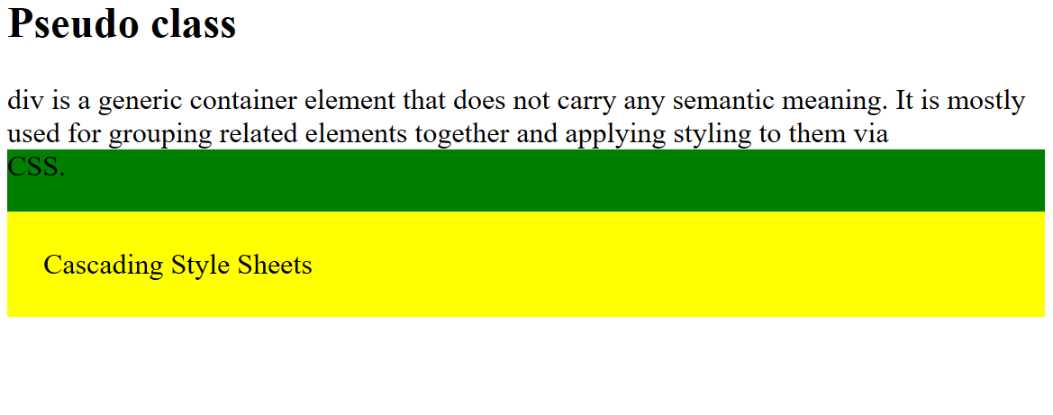
<style>
p {
display: none;
background-color: yellow;
padding: 20px;
}
div {
background-color: green;
}
div:hover p {
display: block;
}
</style>
</head>
<body>
<h2> Pseudo class </h2>
div is a generic container element that does not carry any semantic meaning. It is mostly used for grouping related elements together and applying styling to them via
<div> CSS.
<br><p>Cascading Style Sheets</p>
</div>

Slide 21
Pseudo-elements selectors
A CSS pseudo-element is used to style specified parts of an element.
For example, it can be used to:
Style the first letter, or line, of an element
Insert content before, or after, the content of an element
The syntax of pseudo-elements:
selector::pseudo-element {
property: value;
}

Slide 22
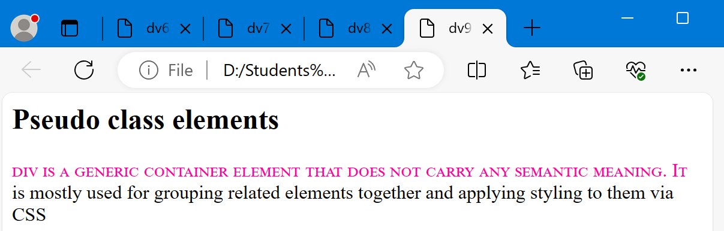
Pseudo-elements selectors
<style>
p::first-line {
color: #ff00A0;
font-variant: small-caps;
}
</style>
</head>
<body>
<h2> Pseudo class elements </h2>
<p>div is a generic container element that does not carry any semantic meaning. It is mostly used for grouping related elements together and applying styling to them via CSS</p>

Slide 23
Pseudo-elements selectors
The following properties apply to the ::first-line pseudo-element:
font properties
color properties
background properties
word-spacing
letter-spacing
text-decoration
vertical-align
text-transform
line-height

Slide 24
Attribute selectors
The [attribute] selector is used to select elements with a specified attribute.

Slide 25
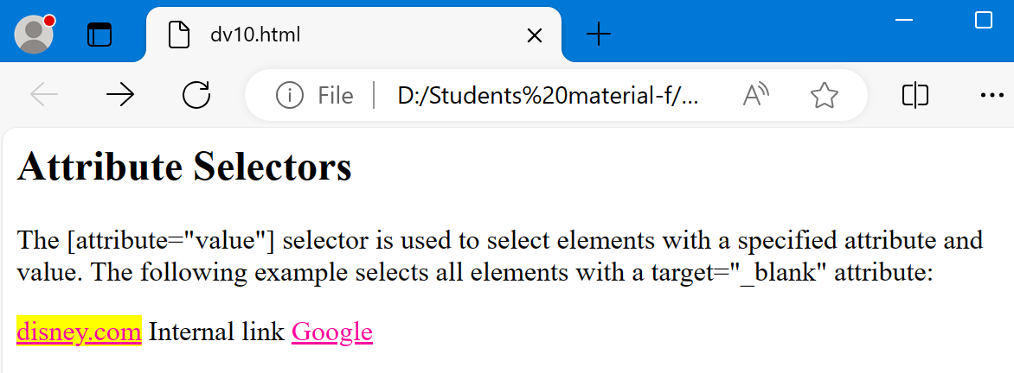
Check for href and target properties in ‘A’ tag
<style>
a[href^="http"] {
color: #ff00A0;
}
a[target="_blank"] {
background-color: yellow;
}
</style>
</head>
<body>
<h2> Attribute Selectors </h2>
<p>The [attribute="value"] selector is used to select elements with a specified attribute and value.
The following example selects all <a> elements with a target="_blank" attribute:</p>
<a href="http://www.disney.com" target="_blank">disney.com</a>
<a hreff="#"> Internal link </a>
<a href="https://www.google.com">Google</a>

Slide 26
Internal Styles
Attaching a specific style class with a specific element
.nodec is an extension of class styles
- this applies to all A elements with class = “nodec” attribute
The default rendering of an A element is underline.
A.nodec { text-decoration: none }
Overrides an element function
If A is used with nodec class the text will not be underlined
<P><A CLASS = "nodec" HREF = "http://school.com">
Go to the School</A></P>

Slide 27
Internal Styles
Possible values for the text-decoration property:
Applies decorations to text within an element
None
underline
overline
line-through
blink (Browsers are not required to support blink)

Slide 28
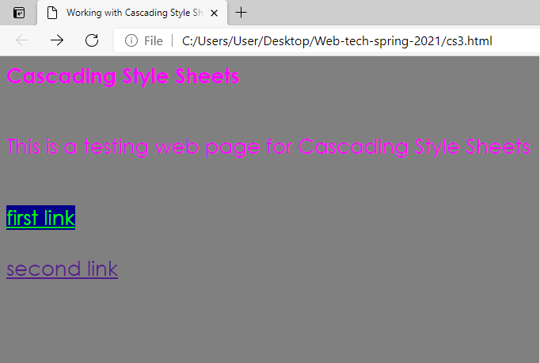
Example of nodec and hover

Slide 29
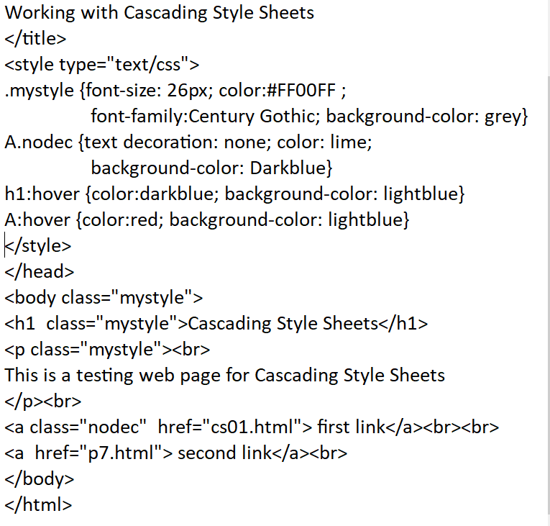

Slide 30
External Styles
The most common place to put style information is in an external document that each page of a web site points to directly.
Any changes made to this single document will then be applied throughout the entire web site as each page is accessed by users.
External Style Sheets have a .css extension.
The .css file should not contain any HTML.
Put .css file within the same directory so the link works.

Slide 31
Linking External Style Sheets
With external linking, separate pages can use the same style sheet.
A link element (in the header section) specifies a relationship between the current document and another document using the ‘rel’ attribute.
For example, suppose we have a style sheet with name mystyles.css.
Then the following declares the linked document with this URL to be a stylesheet (and the MIME type to be text/css):
<link rel = “stylesheet” type = “text/css” href = “mystyles.css”>

Slide 32
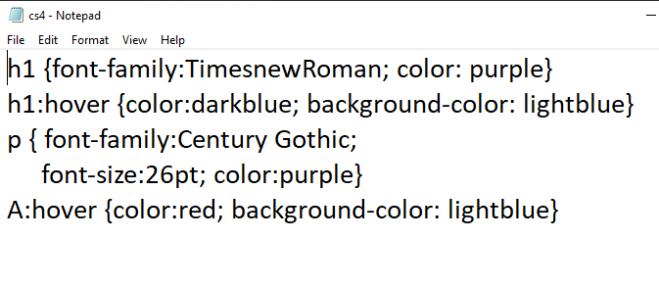
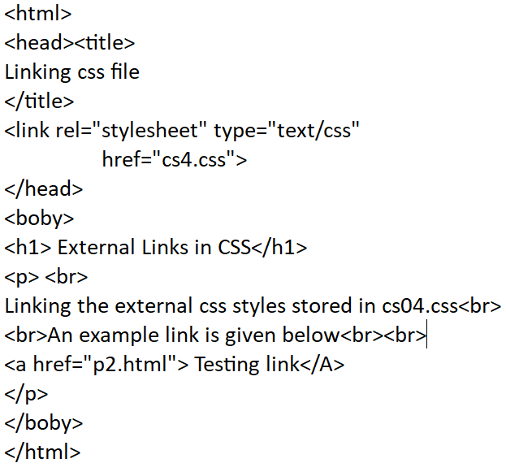
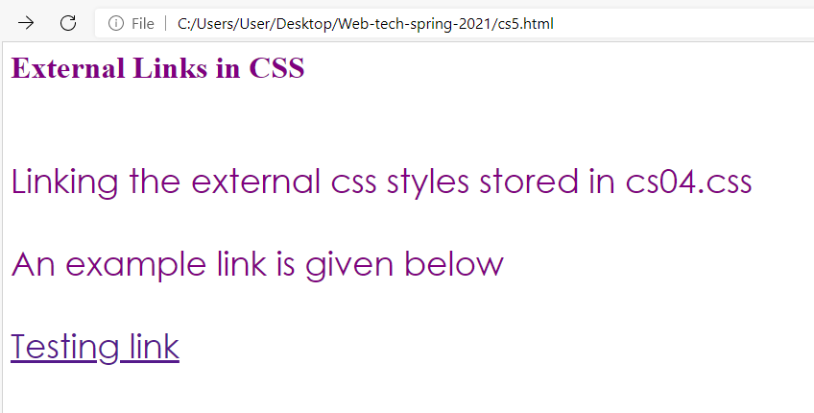
Example

Slide 33
Lab 7
Design a web page using all types of selectors and different properties to show text, headings, paragraphs, and links

